Slide 1
Data Analyst Project
Project Title :- Analyzing Research on Cardiac Diseases

Slide 2
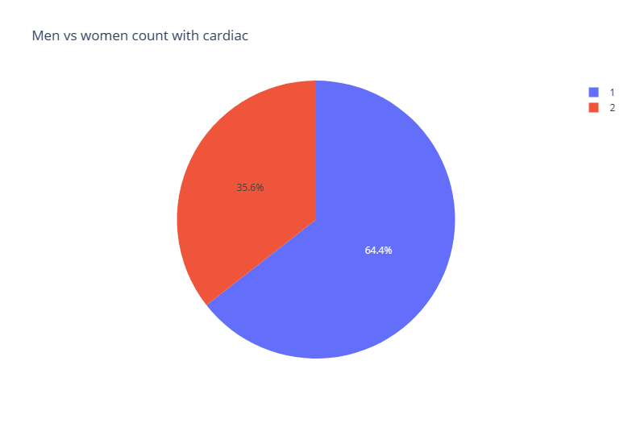
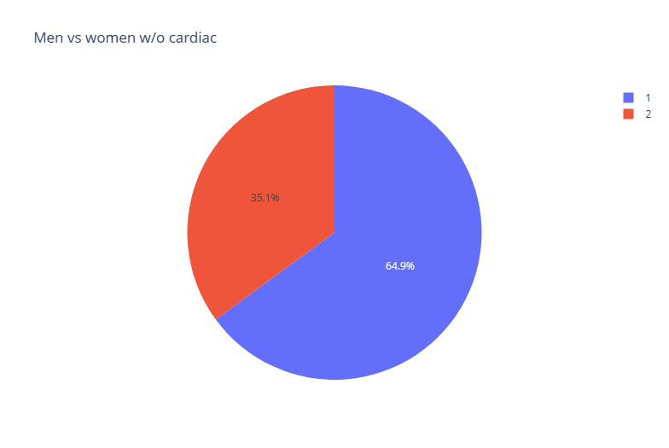
Gender EDA
When it comes to cardiac disease, there is no clear indication that one gender is more susceptible than the other.
1=Men
2=Women

Slide 3
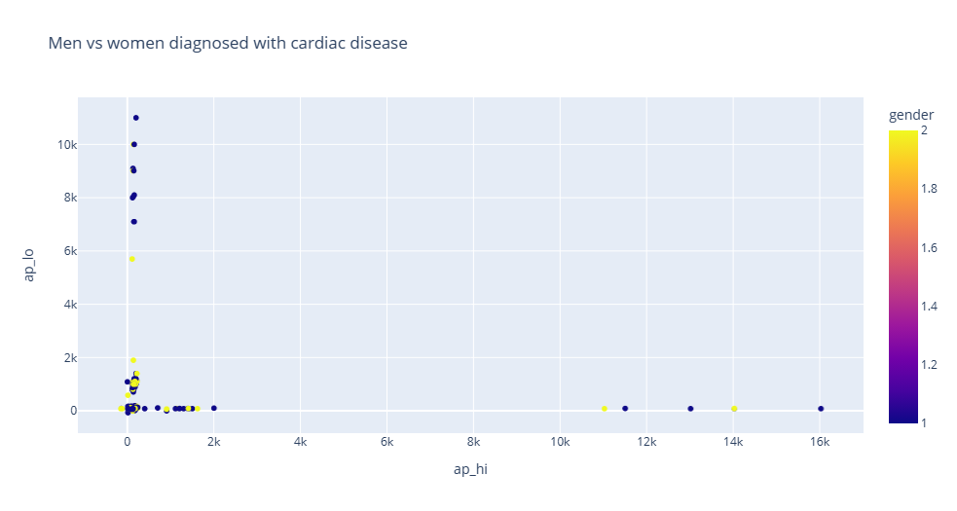
Blood pressure EDA
ap_hi - Systolic blood pressure
ap_lo - Diastolic blood pressure
For men
when diastolic blood pressure is < 11000 & >70 cardio =1
when systolic blood pressure is
< 16200 & >15 cardio=1
For women
when diastolic blood pressure is
< 5700 & >0 cardio=1
when systolic blood pressure is
< 140200 & >150 cardio=1

Slide 4
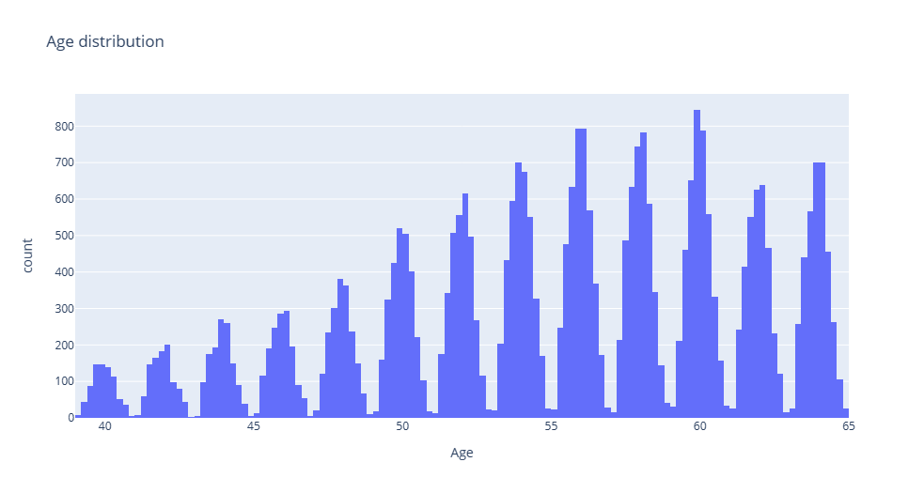
Age Distribution
Age wise distribution of people with cardiac
'Age' > 50 & 'Age’ < 60 = 18350
'Age' > 50 = 7880
'Age’ < 60 = 8729

Slide 5
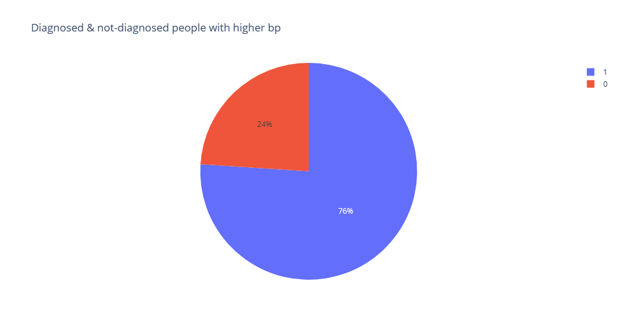
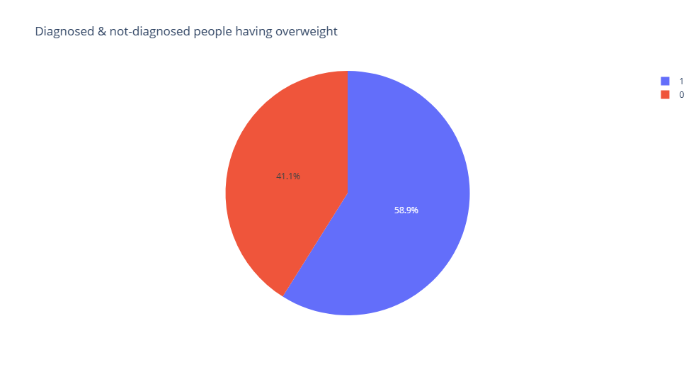
Higher weight vs higher BP
Individuals whose systolic blood pressure surpasses their average levels are at a higher risk of developing a cardiac disease.

Slide 6
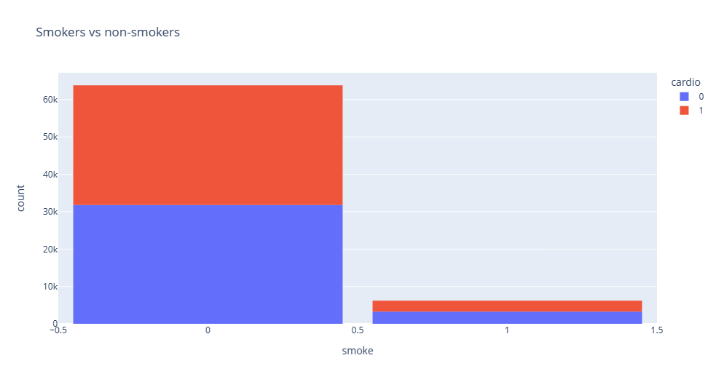
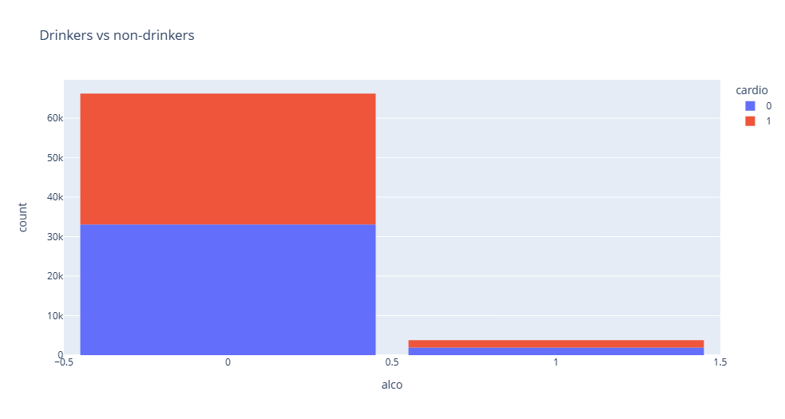
Smokers & Drinkers
While a person's smoking and drinking habits may be strong indicators, they alone cannot guarantee the likelihood of developing a cardiac disease.

Slide 7
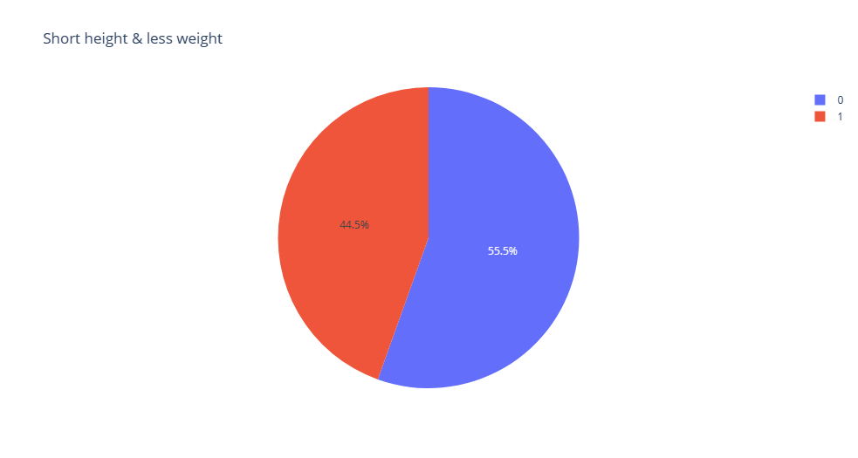

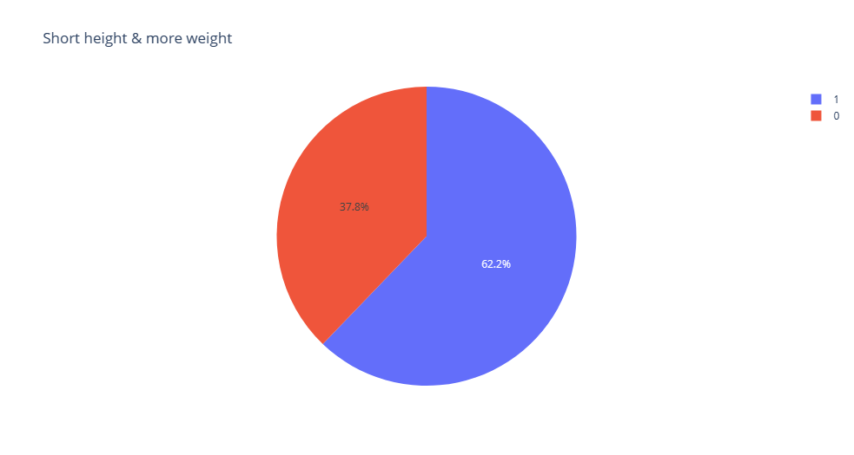
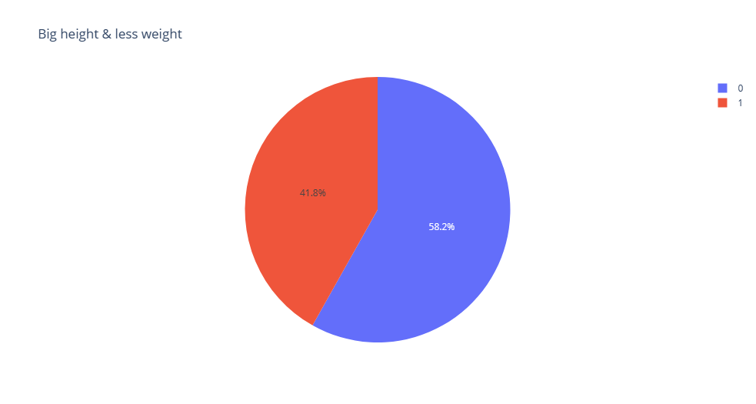
Height & weight categories
While height and weight categories are often used to assess an individual's health status, it would be incorrect to define them as reliable indicators of cardiac disease.

Slide 8
Conclusion
In conclusion,
after analyzing the given dataset, it is evident that age and systolic blood pressure are the two primary indicators of cardiac disease.
While weight, smoking, and drinking habits are important factors to consider, they play a secondary role in determining the likelihood of developing a cardiac disease.
Therefore, it is crucial to prioritize monitoring age and systolic blood pressure levels in order to effectively prevent and manage the cardiac disease.

